Slide 1
Model Prediction for Applicant Job Status
Name Ugwunwa Stella Ngoyika
Contact: mstella365gmail.com

Slide 2
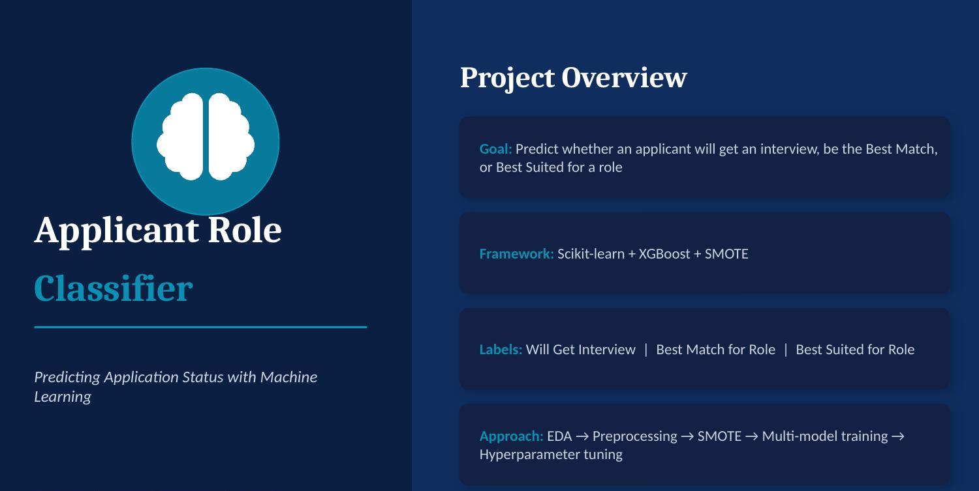

Slide 3

Objectives of this Model Project
To develop a machine learning model that automatically evaluates job applicants based on their experience, skills, education, and other qualifications, and classifies each applicant into one of three categories: Best Suited for Role, Best Match for Role, or Will Get Interview.
The goal is to support applicants/recruiters by quickly highlighting strong candidates and reducing the time spent manually screening applications and sending out while ensuring every applicant is still reviewed fairly within the appropriate tier.
The model was trained and tested on applicant data, achieving over 90% accuracy, with the Random Forest approach selected as the best-performing and most reliable option for this task.

Slide 4
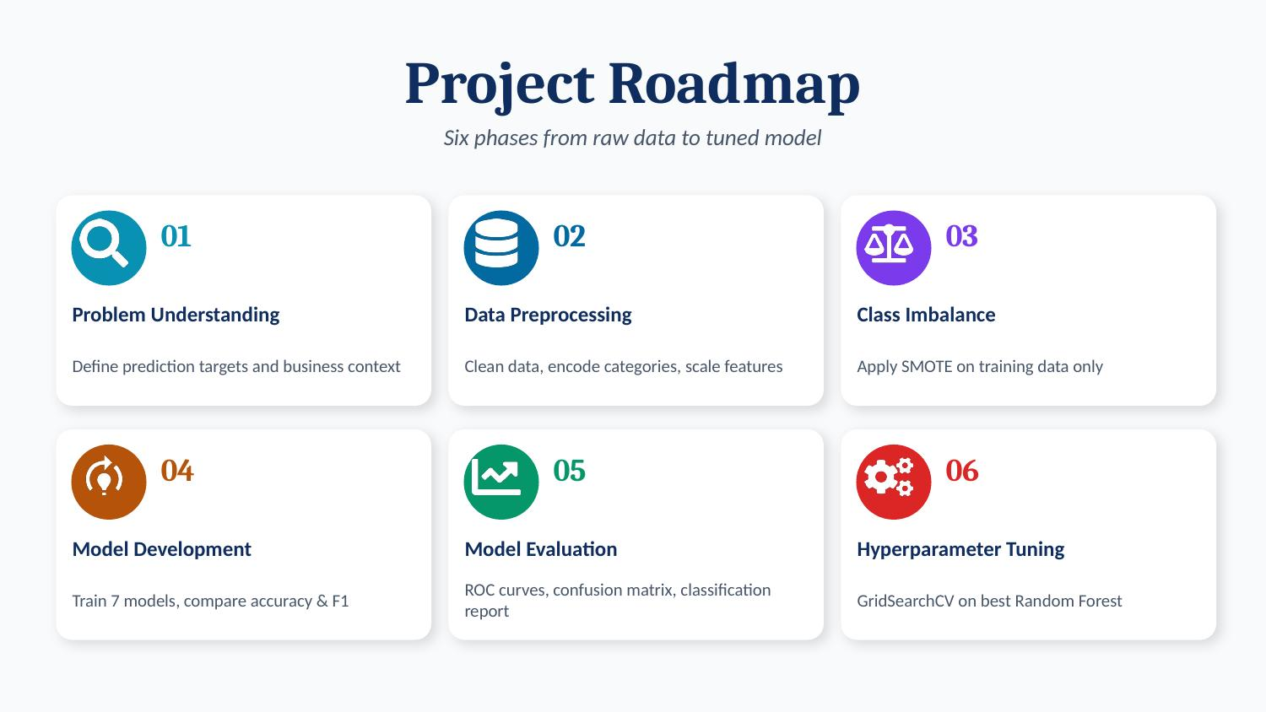

Slide 5
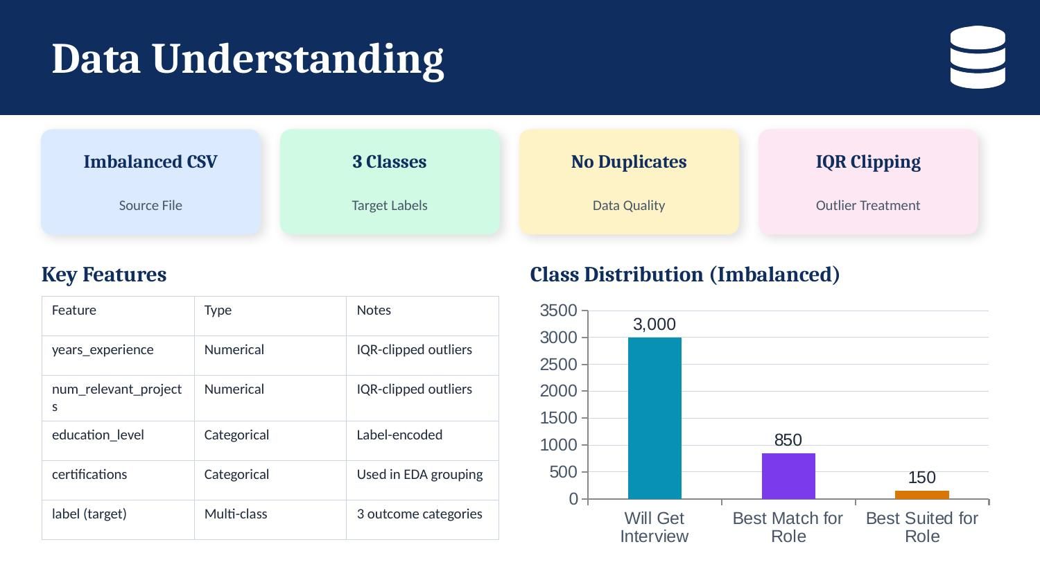

Slide 6
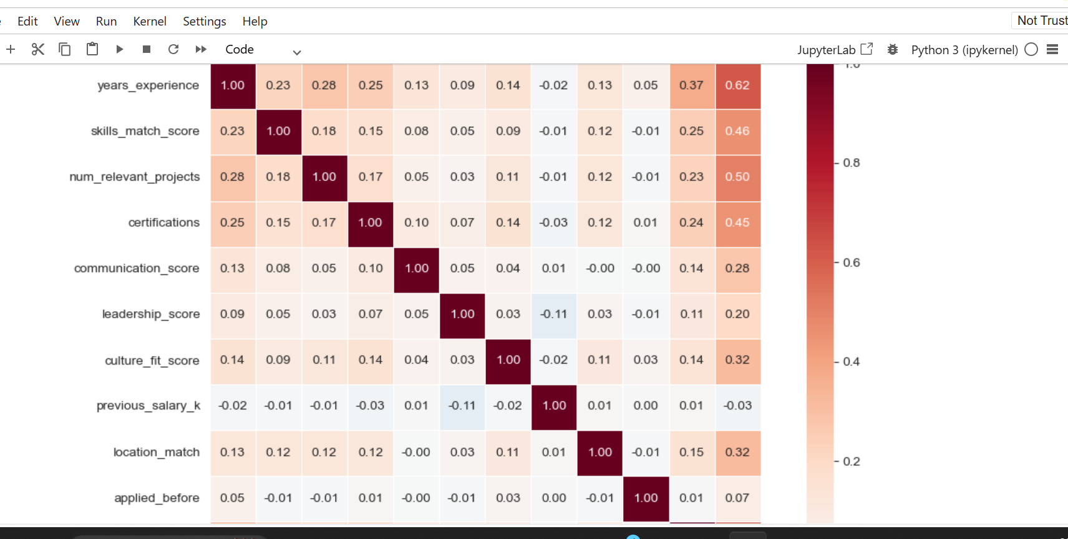

Features Correlation

Slide 7
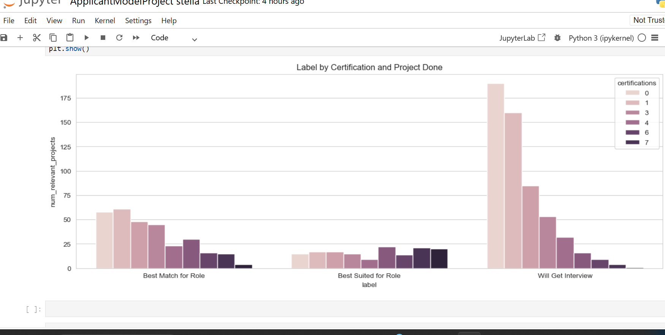
Certification and Project done

Slide 8
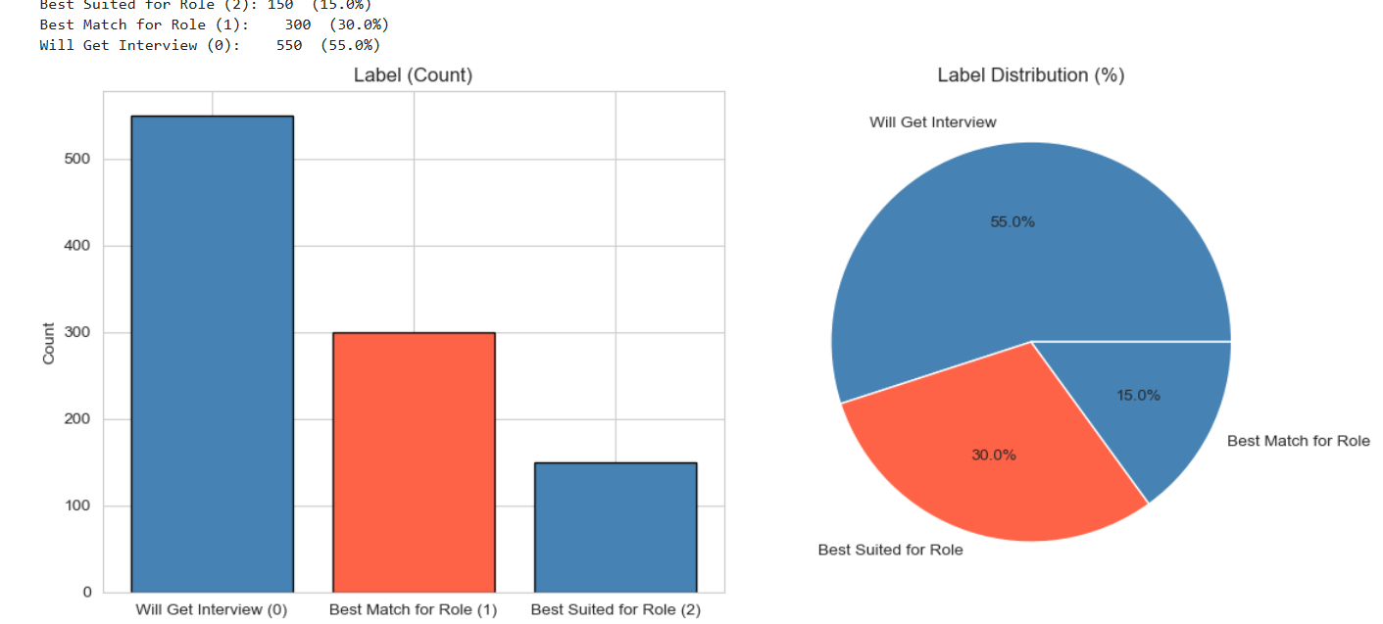
Label Distribution

Slide 9
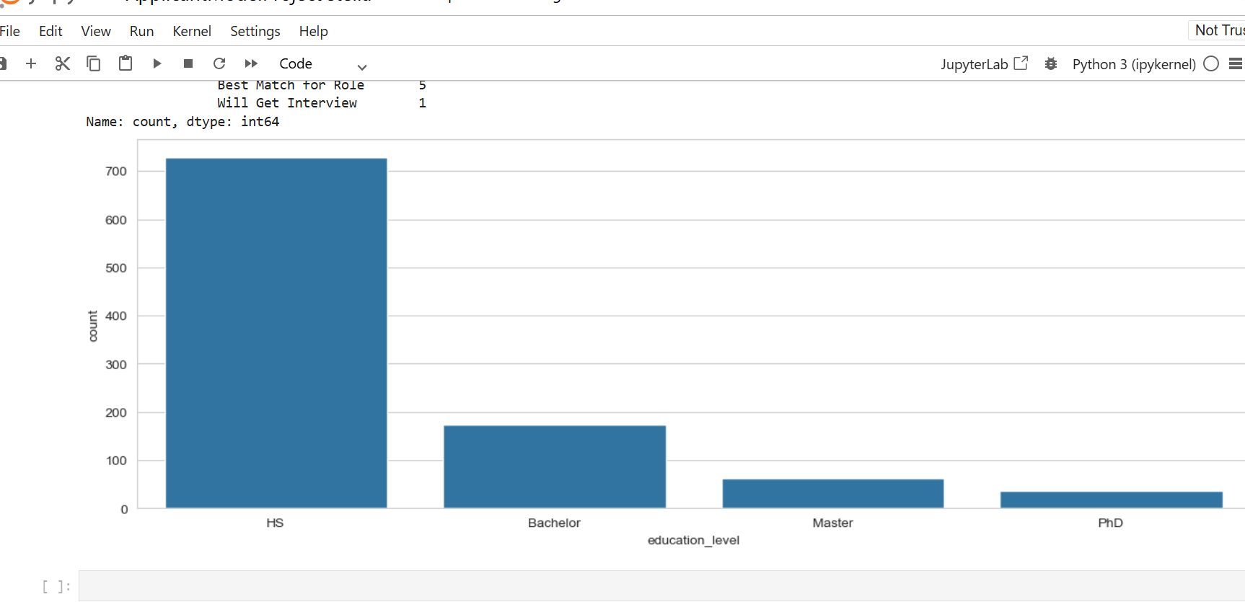
.
Education-Level Count

Slide 10
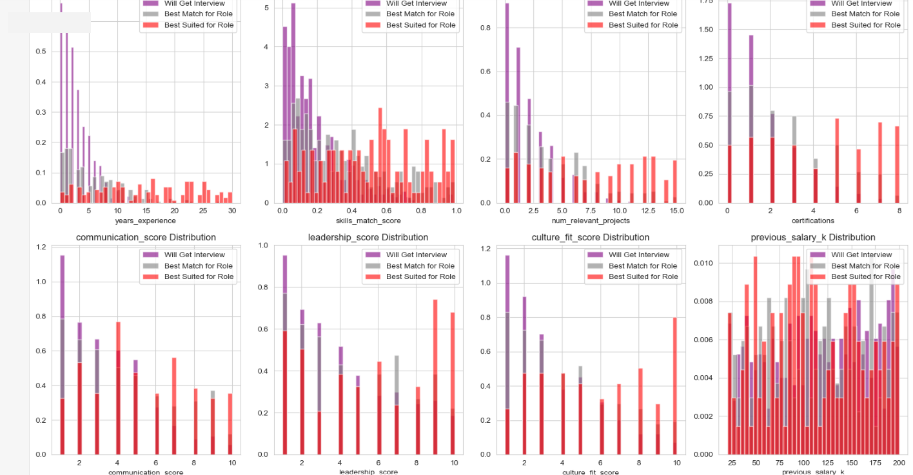
Numerical Features By Labels

Slide 11
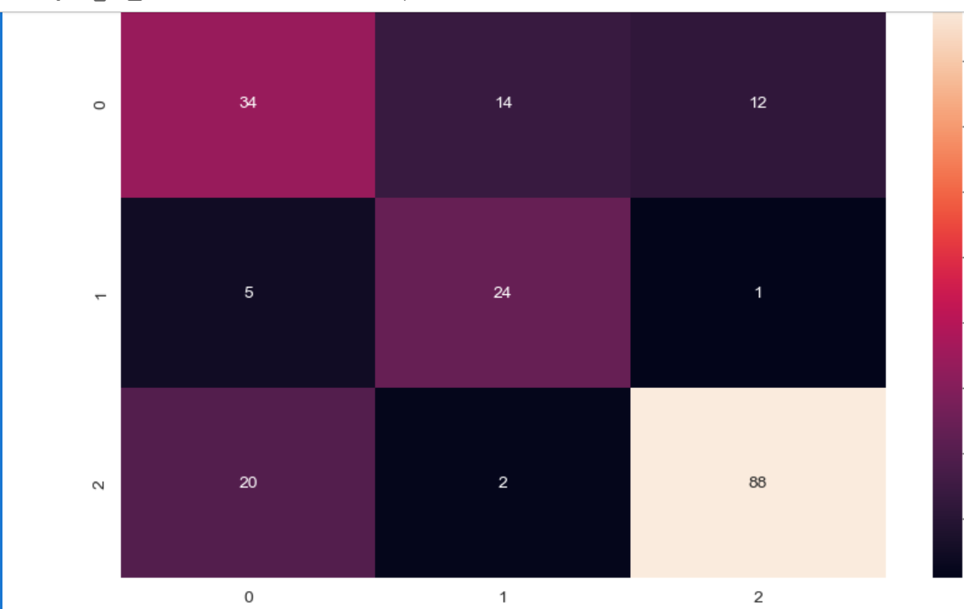
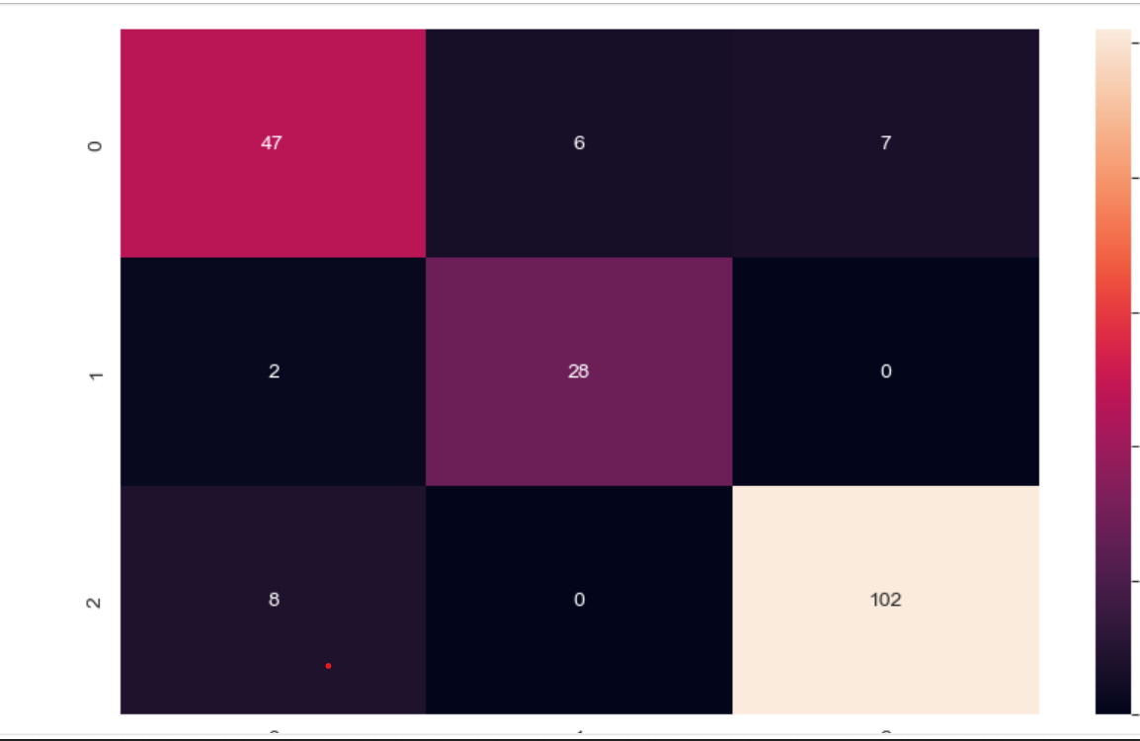
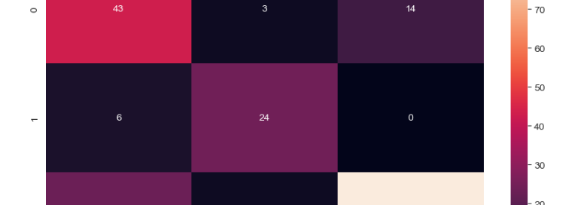
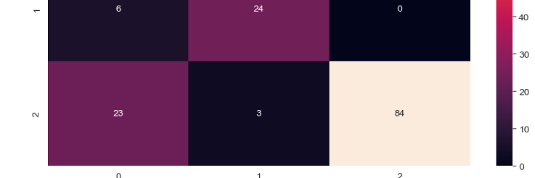
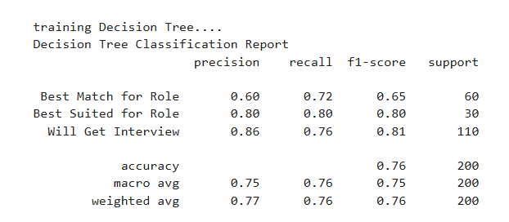
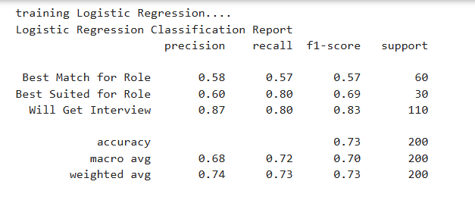
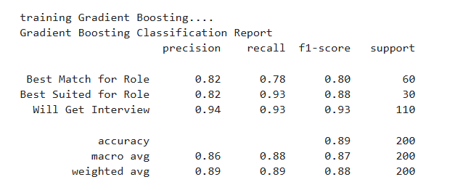
Model Comparison
Step 3: adjust the layout
Choose a layout from 19 stylings. ‘Title with body’ works quite well.

Slide 12
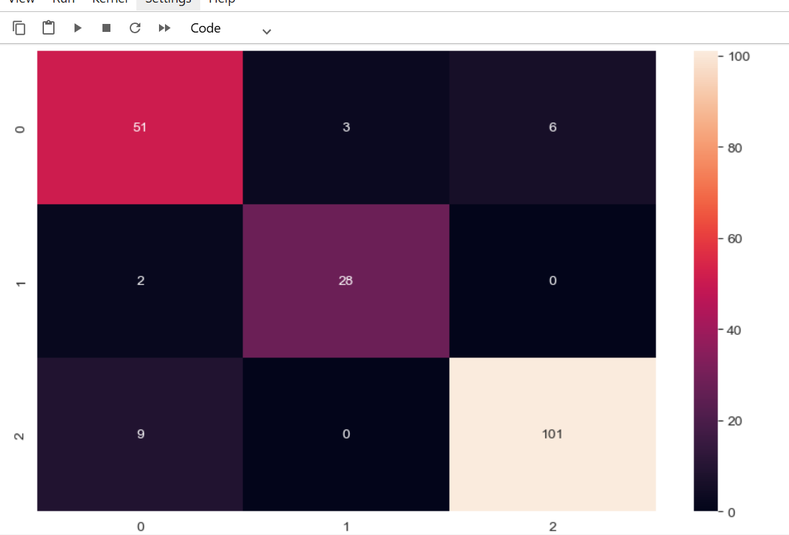
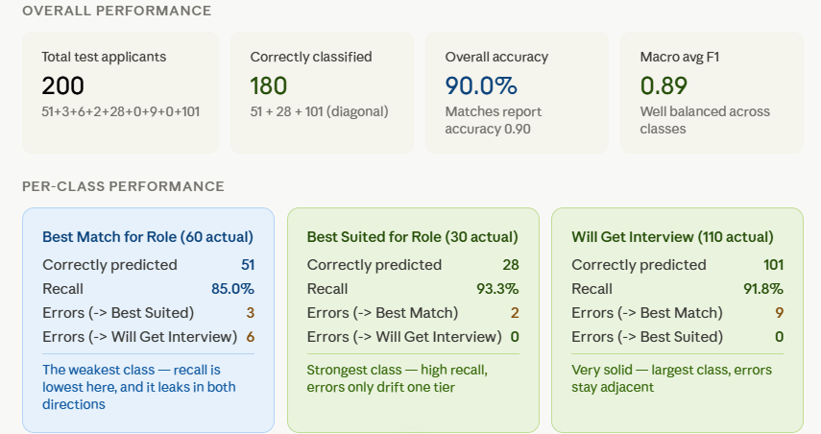
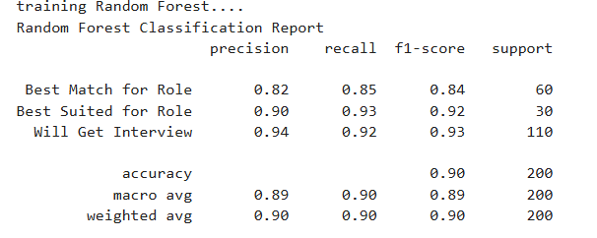

Best Model

Slide 13
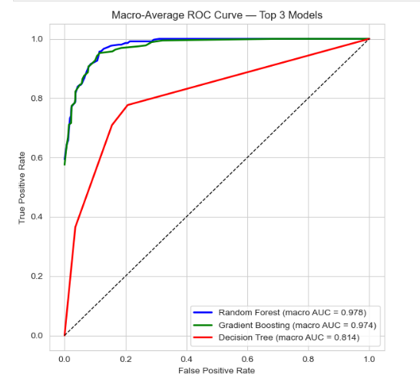
AUC Curve Comparison
Two of the three models — Random Forest and Gradient Boosting — perform excellently, scoring 97-98 out of 100 on our overall accuracy scale (technically called "AUC", but think of it as a percentage score).
The third model, Decision Tree, lags noticeably behind at 81 out of 100.
In practical terms: if we deployed Random Forest or Gradient Boosting, the model would almost always correctly sort applicants into the right category. If we used Decision Tree, it would get things right most of the time, but would make noticeably more mistakes — especially for borderline cases.

Slide 14
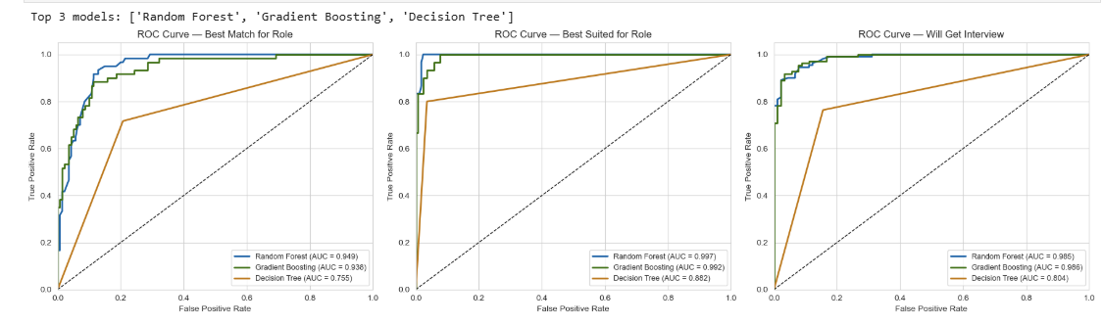
Auc Curve Comparison
For "Best Suited for Role" — all three models do very well here, with Random Forest and Gradient Boosting scoring nearly perfectly (99-100 out of 100). Even Decision Tree does reasonably well (88 out of 100) on this category.
For "Will Get Interview" — Random Forest and Gradient Boosting again score excellently (98-99 out of 100), while Decision Tree drops to 80 out of 100.
For "Best Match for Role" — this is the hardest category for every model. Random Forest and Gradient Boosting still perform well (93-95 out of 100), but Decision Tree drops significantly to 75 out of 100.

Slide 15
Thanks a lot!

